Slide 1
JSON File
IMAGE ORGANIZER APPLICATION
UNDER THE GUIDANCE OF - Dr. Durgansh Sharma

Slide 2
What is Json
JSON: JavaScript Object Notation.
JSON is a syntax for storing and exchanging data.
JSON is text, written with JavaScript object notation

Slide 3
String url="http://192.168.220.120:5111/sp";
filename1[x]=imagefile.getName();
x++;
StringRequest stringRequest = new StringRequest(Request.Method.POST, url, new Response.Listener<String>() {
@Override
public void onResponse(String response){
z++;
Toast.makeText(s1,"Image "+response.substring(1)+" Accessed.",Toast.LENGTH_LONG).show();
if(response.substring(0,1).equals("0")) {
File j = new File(spath + "/FamilyPhotos/"+ filename1[y]);
boolean t=imagefile.renameTo(j);
y++;
}
if(response.substring(0,1).equals("1")) {
File j = new File(spath + "/DocumentImages/" +
}
})

Slide 4
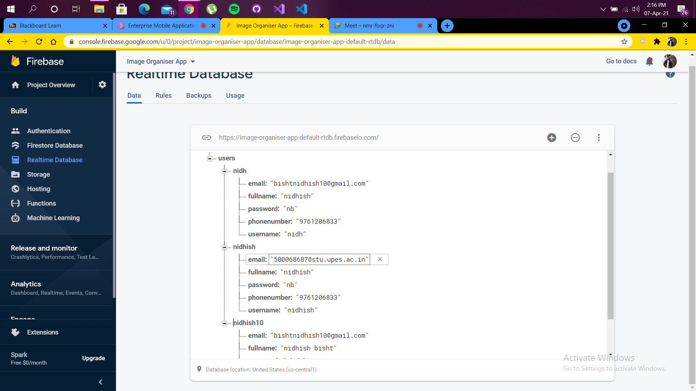

Slide 5
Admin Panel
android.app.admin
Kotlin |Java
Provides device administration features at the system level, allowing you to create security-aware applications that are useful in enterprise settings, in which IT professionals require rich control over employee devices.

Slide 6
Classes
ConnectEvent A class that represents a TCP connect event initiated through the standard network stack.
DelegatedAdminReceiver Base class for delegated apps to handle callbacks related to their delegated capabilities.
DeviceAdminInfo This class is used to specify meta information of a device administrator component.
DeviceAdminReceiver Base class for implementing a device administration component.
DeviceAdminService Base class for a service that device owner/profile owners can optionally have.
DevicePolicyManager Public interface for managing policies enforced on a device.

Slide 7
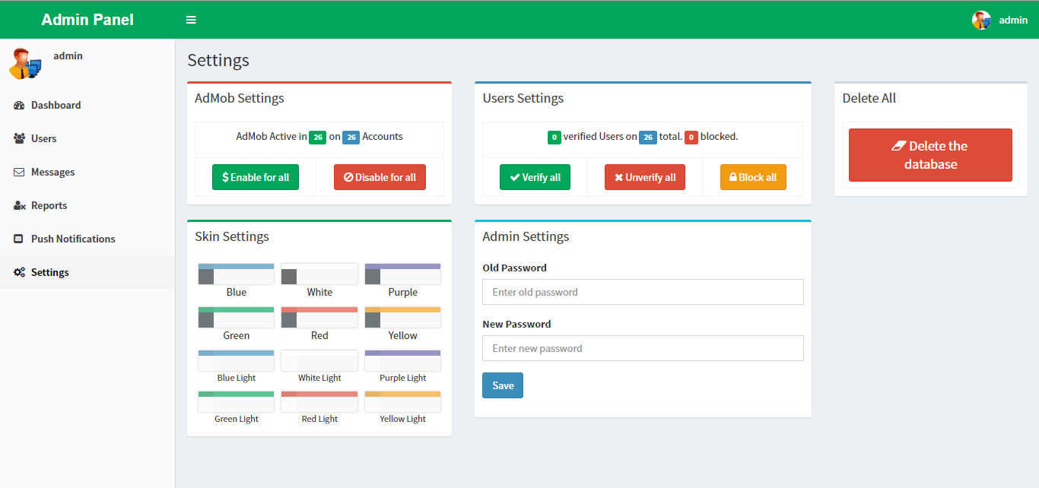

Slide 8
Thank You.

